Slide 1
Soccer Game Scoring Interface System
Team Byte Benders
IST 659
Database Administration Concepts
&
Database Management

Slide 2
Business Problem
Gap in Current Market
Stakeholder Benefit
Ease of access & Data Management

Slide 3
Business Use case - Customizable One stop platform
Analysts
Coaches
Players
Fans
Broadcasters

Slide 4
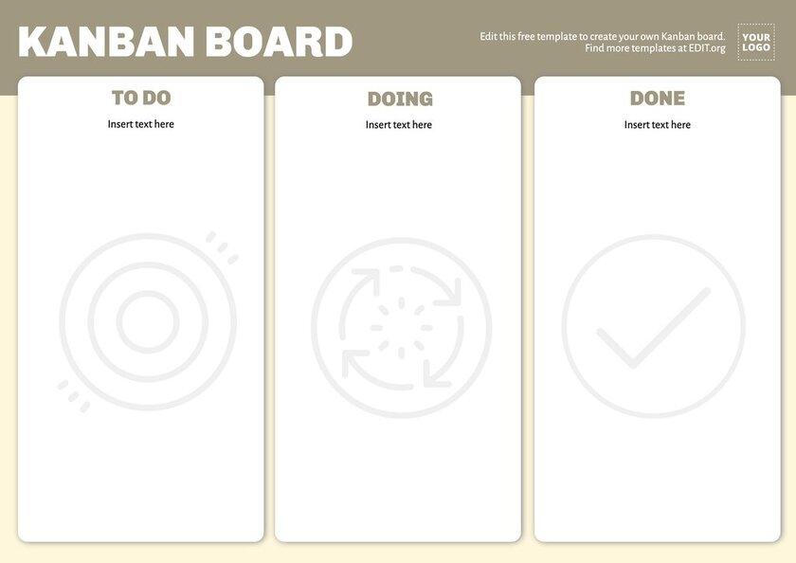
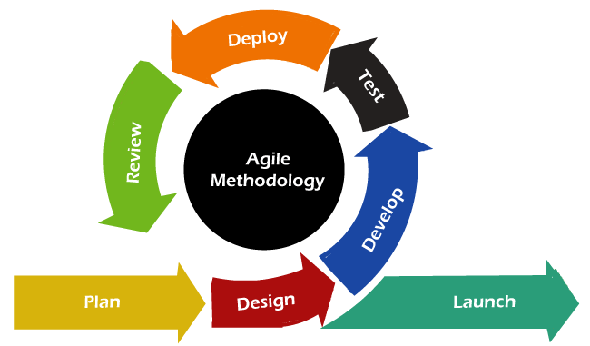
Milestones and Management
Steering Projects to Success

Slide 5
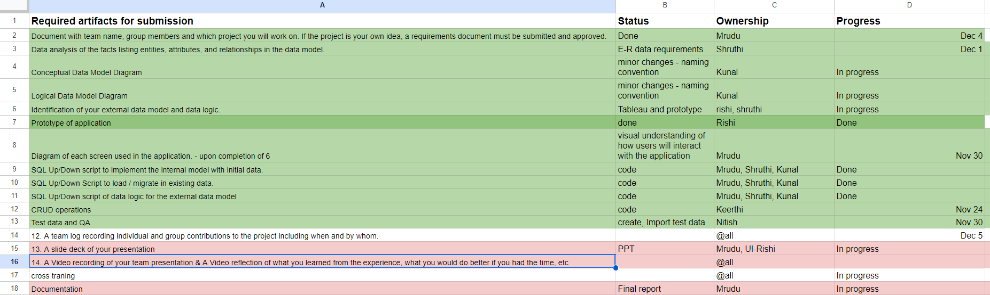
Project Roadmap

Slide 6
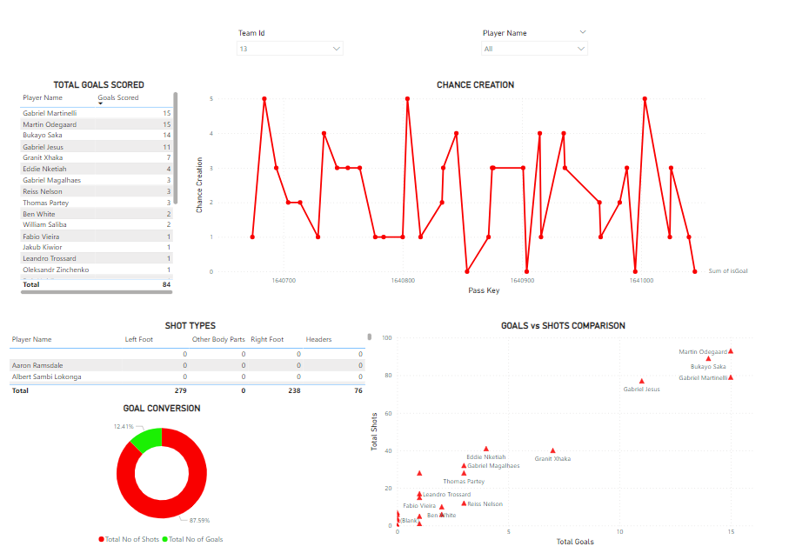
Prototype Created

Slide 7
Initial Data Selection
DATA CLEANING
DATA SCRAPING
Formatted and refined the dataset to 150 columns and 50k records.
Scrapped a dataset with 250 variables and 0.3 million records from OPTA-code.

Slide 8
SQL Up-Down Script
External Data Model
Crud Operations
Loading the master database each time is a costly task
We made a sql up-down script to create multiple views.
All the views are used in dashboards.
Some functionalities of the dashboards required values of some derived columns
Made an up-down script to create the necessary columns by aggregating the master table.

Slide 9
Strategic Dashboard Development: Design and Execution
Business Logic
Data Logic
Dashboard
Decided on what views to be included in the dashboard
Finalized on what data to use for visualization
Created interactive visualization figures as views
01
02
03

Slide 10


Creating an Outline: Conceptual & ER diagram
Set database for Scripting and Data Migration

Slide 11
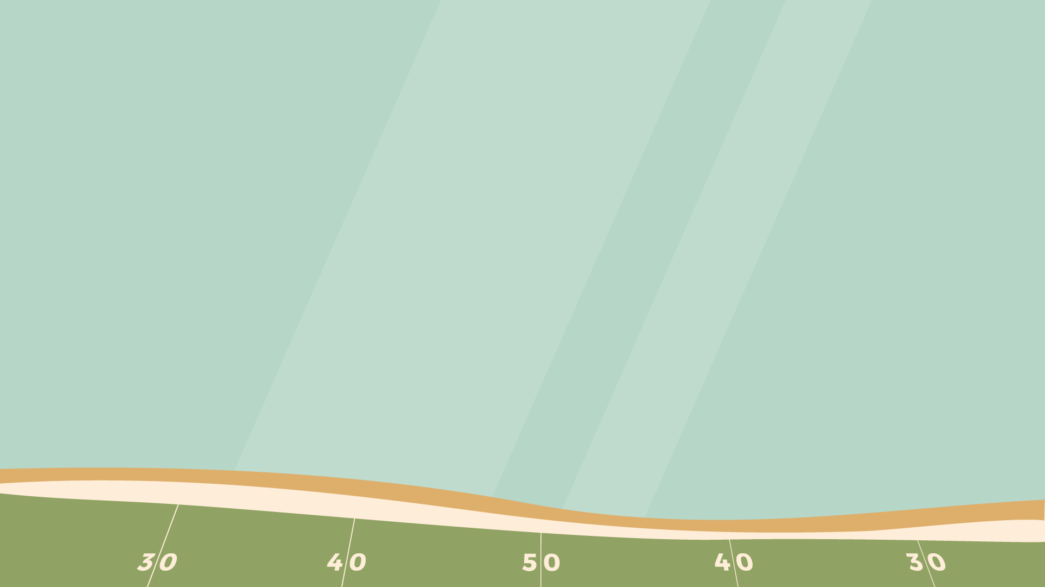
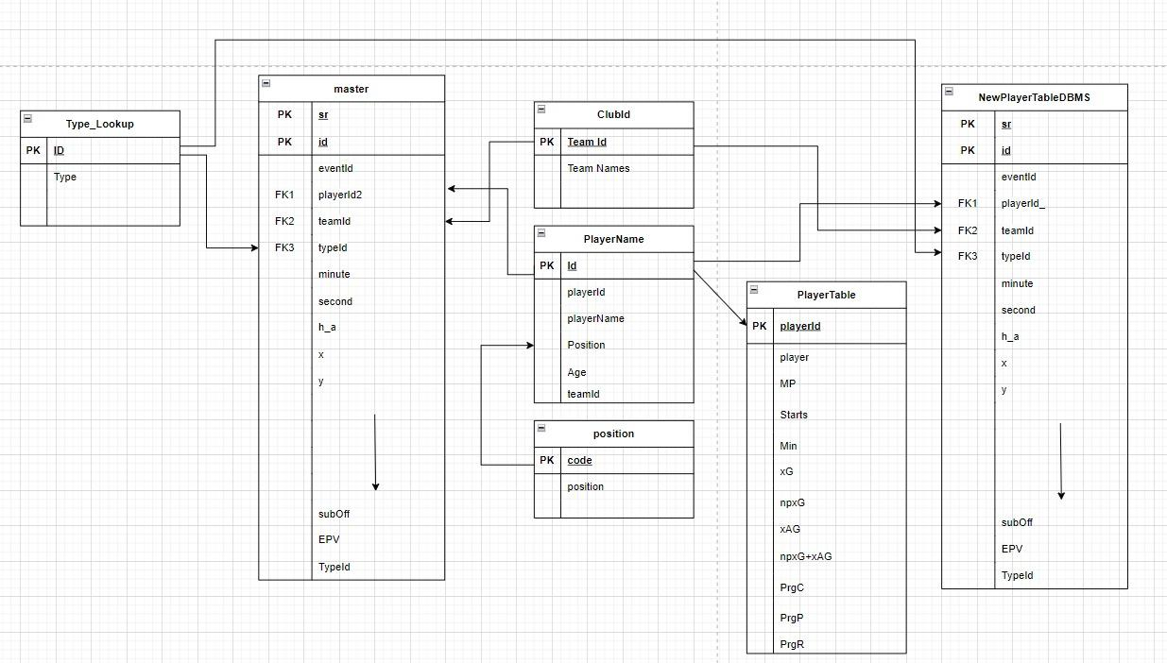
Logical data model

Slide 12
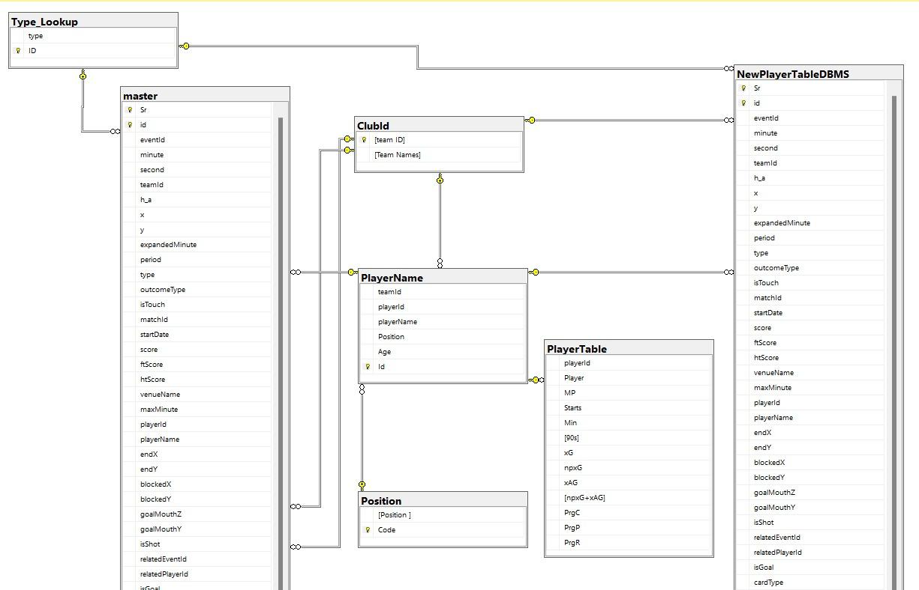
Conceptual Data Model

Slide 13

Quality Craftsmanship: Testing and Ensuring Excellence
Primary Key Constraint
Data Type Constraint
Ensures each record is unique and identifiable
Dictates the kind of data permitted in a column, such as integers or text
Foreign Key Constraint
Unique Constraint
Guarantees referential integrity by linking tables correctly
Prevents duplicate values in a column to maintain data uniqueness
Check Constraint
Confirms that all entries in a column satisfy a specified condition

Slide 14
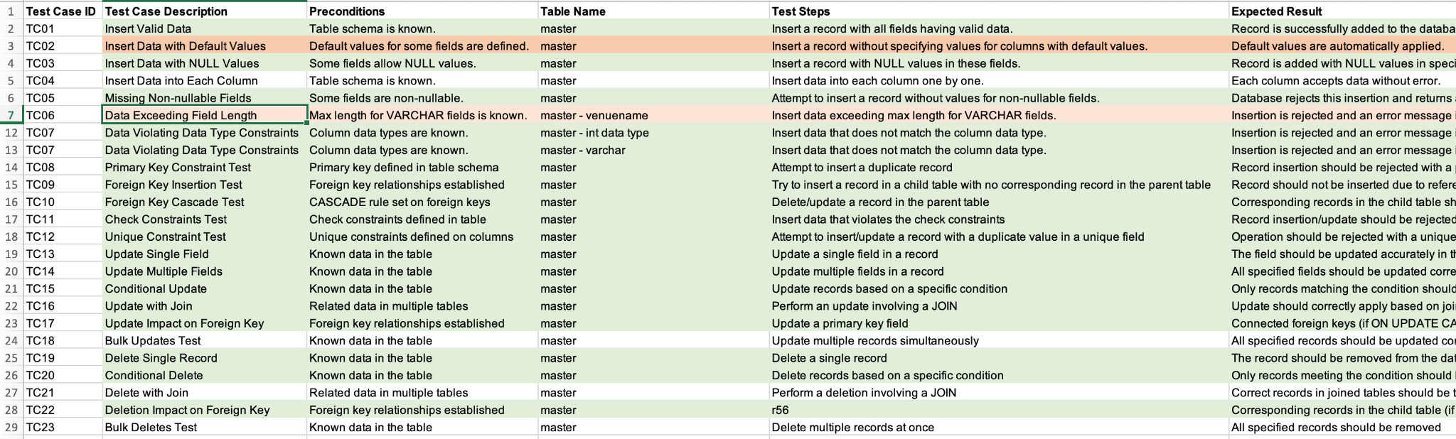
Screenshots of QA

Slide 15
Bridging CRUD & Visualizations
Designed and implemented the Home Page, focusing on user-friendly interface and intuitive design.
Developed the Player Dashboard, incorporating advanced Create, Read, Update, and Delete (CRUD) operations using SQL for efficient data management.
Created a streamlined Navigation Form, enhancing overall usability and navigation efficiency within the application.

Slide 16
Soccer is like life: It requires perseverance, self denial, hard work, sacrifice, dedication, and respect for authority.
-Vince Lombardi

Slide 17
THANK You!
Team Byte Benders:
Keerthi Krishna Aiyappan
Kunal Shirodkar
Mrudu Lahari Malayanur
Nithish Kumar
Rishikesh Ramesh
Shruti Kamath

